Slide 1
Yelp Recommendation
A Comparision of Cluster and User-to-User Algorithm
Ellen Hsieh, Fulin Guo, Jiaxu Han, Ying Sun Computational Social Science University of Chicago

Slide 2
Content
Dataset Description
Hypotheses
Algorithms
Big Data Approach - MapReduce
Challenges
Results
References

Slide 3
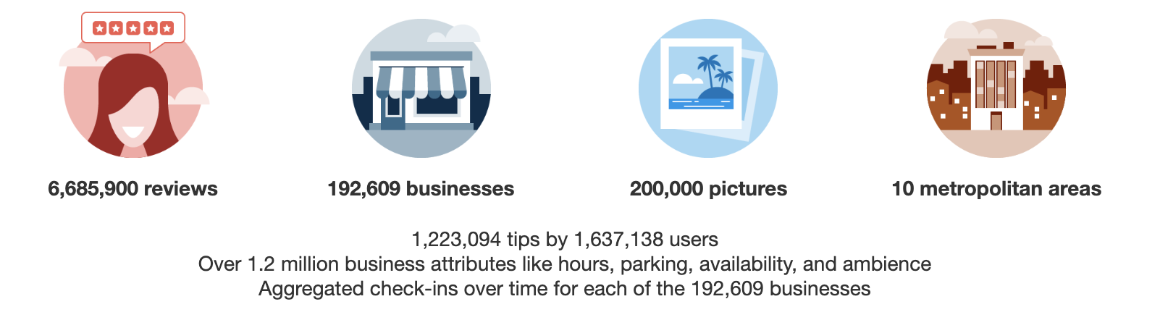
Description of Dataset
Original Yelp Dataset (about 8GB)
What we actually used:
1 million reviews from review.json

Slide 4
Hypotheses
Some people have similar taste in choosing restaurants.
User-to-user algorithm has a higher prediction accuracy than clustering algorithm for recommending the businesses for the user.

Slide 5
Algorithms
User-to-User: Calculate the similarity scores for every two users. Then for each user, select 5 users / 3 users that have the highest similarity scores with respect to this user. We also calculate the prediction accuracy and select parameters using the test set.
Cluster Algorithm: Classify users based on whether they “like” same restaurants. The parameters include the threshold of ratings, the threshold of times visiting the same restaurant, and the threshold of times two users exist in the same sub-cluster. We use the same criteria as the user-to-user algorithm to calculate the prediction accuracy in the test set.

Slide 6
big data approach: Mapreduce
Cluster Algorithm: 3-Step MapReduce Implementation
1st step: Get the tuples (ratings, visit times) for all the customers for each business. We used the business as the key and the tuples (rating, visit times) as the value.
2nd step: Use the random variable generated by python to decide whether the business be put in the training set or the test set. If the business set is in the training set, we decide which users should be classified in the same subclassification. If the business set is in the test set, we calculate whether the two users are truly similar in selecting this restaurant. This step yields subclassifications of users (if the business is in the training set) and the number of successful predictions for user pairs visiting this restaurant (if the business is in the test set).
3rd step: For the training set, we combined subclassifications to generate the final classification of users based on the times threshold. For the test set, we calculated the prediction accuracy rates.

Slide 7
big data approach: Mapreduce
User-to-User Algorithm: 4-Step MapReduce Implemention
1st step: Get the tuples (rating, visiting times) for all the customers for each business (key: business id, value: the tuple)
2nd step: Giving different weights for ratings and visit times to construct similarity scores for each user pairs (training/test = 0.7/0.3). (key: user pair, value: similarity score)
3rd step: Find the top 5/top 3 most similar users
4th step: Compute the accuracy scores to evaluate the model (select the parameter to determine the best weights split between ratings and visiting times.)
Friend recommendation: the highest -similarity-score user

Slide 8
challenges
Solved (or kind of solved):
Unzip big data file and store it
Convert large json file to csv file
Using mrjob
Algorithm
calculate prediction accuracy
perparameter tuning and run time: 2~3 hours for each user-to-user model, ~30 minutes for each cluster model
MapReduce + Google cloud VM instance (16 CPU, 6 cores, 50 GB disk) + Dataproc, can only run 1 million data (Permission denied problem while running MrJob code)
Still have question:
Combining two results from MapReduce
Using iterative mapreduce to implement k-means method

Slide 9
results -Model Selection
Model | User-to-User | User-to-User | User-to-User | User-to-User
Parameter | Frequency weight: 0.5 Rating weight: 0.5 Top 5 similar users | Frequency weight: 0.7 Rating weight: 0.3 Top 5 similar users | Frequency weight: 0.7 Rating weight: 0.3 Top 3 similar users | Frequency weight: 0.9 Rating weight: 0.1 Top 3 similar users
Prediction Accuracy | Prior: 0.6667481608020919 Post: 0.6639369244020407 | Prior: 0.6666976368553207 Post: 0.6737991618310767 | Prior: 0.6667046212301068, Post: 0.6769557999584976 | Prior: 0.6666575201470023, Post: 0.6800968220504412
Model | Cluster | Cluster | Cluster | Cluster
Parameter | Frequency threshold: 1 Rating threshold: 2 Times threshold: 1 | Frequency threshold: 1 Rating threshold: 3 Times threshold: 1 | Frequency threshold: 1 Rating threshold: 3 Times threshold: 2 | Frequency threshold: 1 Rating threshold: 4 Times threshold: 1
Prediction Accuracy | Prior: 0.6685598510496469 Post: 0.7611386138613861 | Prior: 0.673182786646351 Post: 0.75 | Prior: 0.6885730674465395 Post: 1.0 | Prior: 0.6739148305405427 Post: 0.7765726681127982

Slide 10
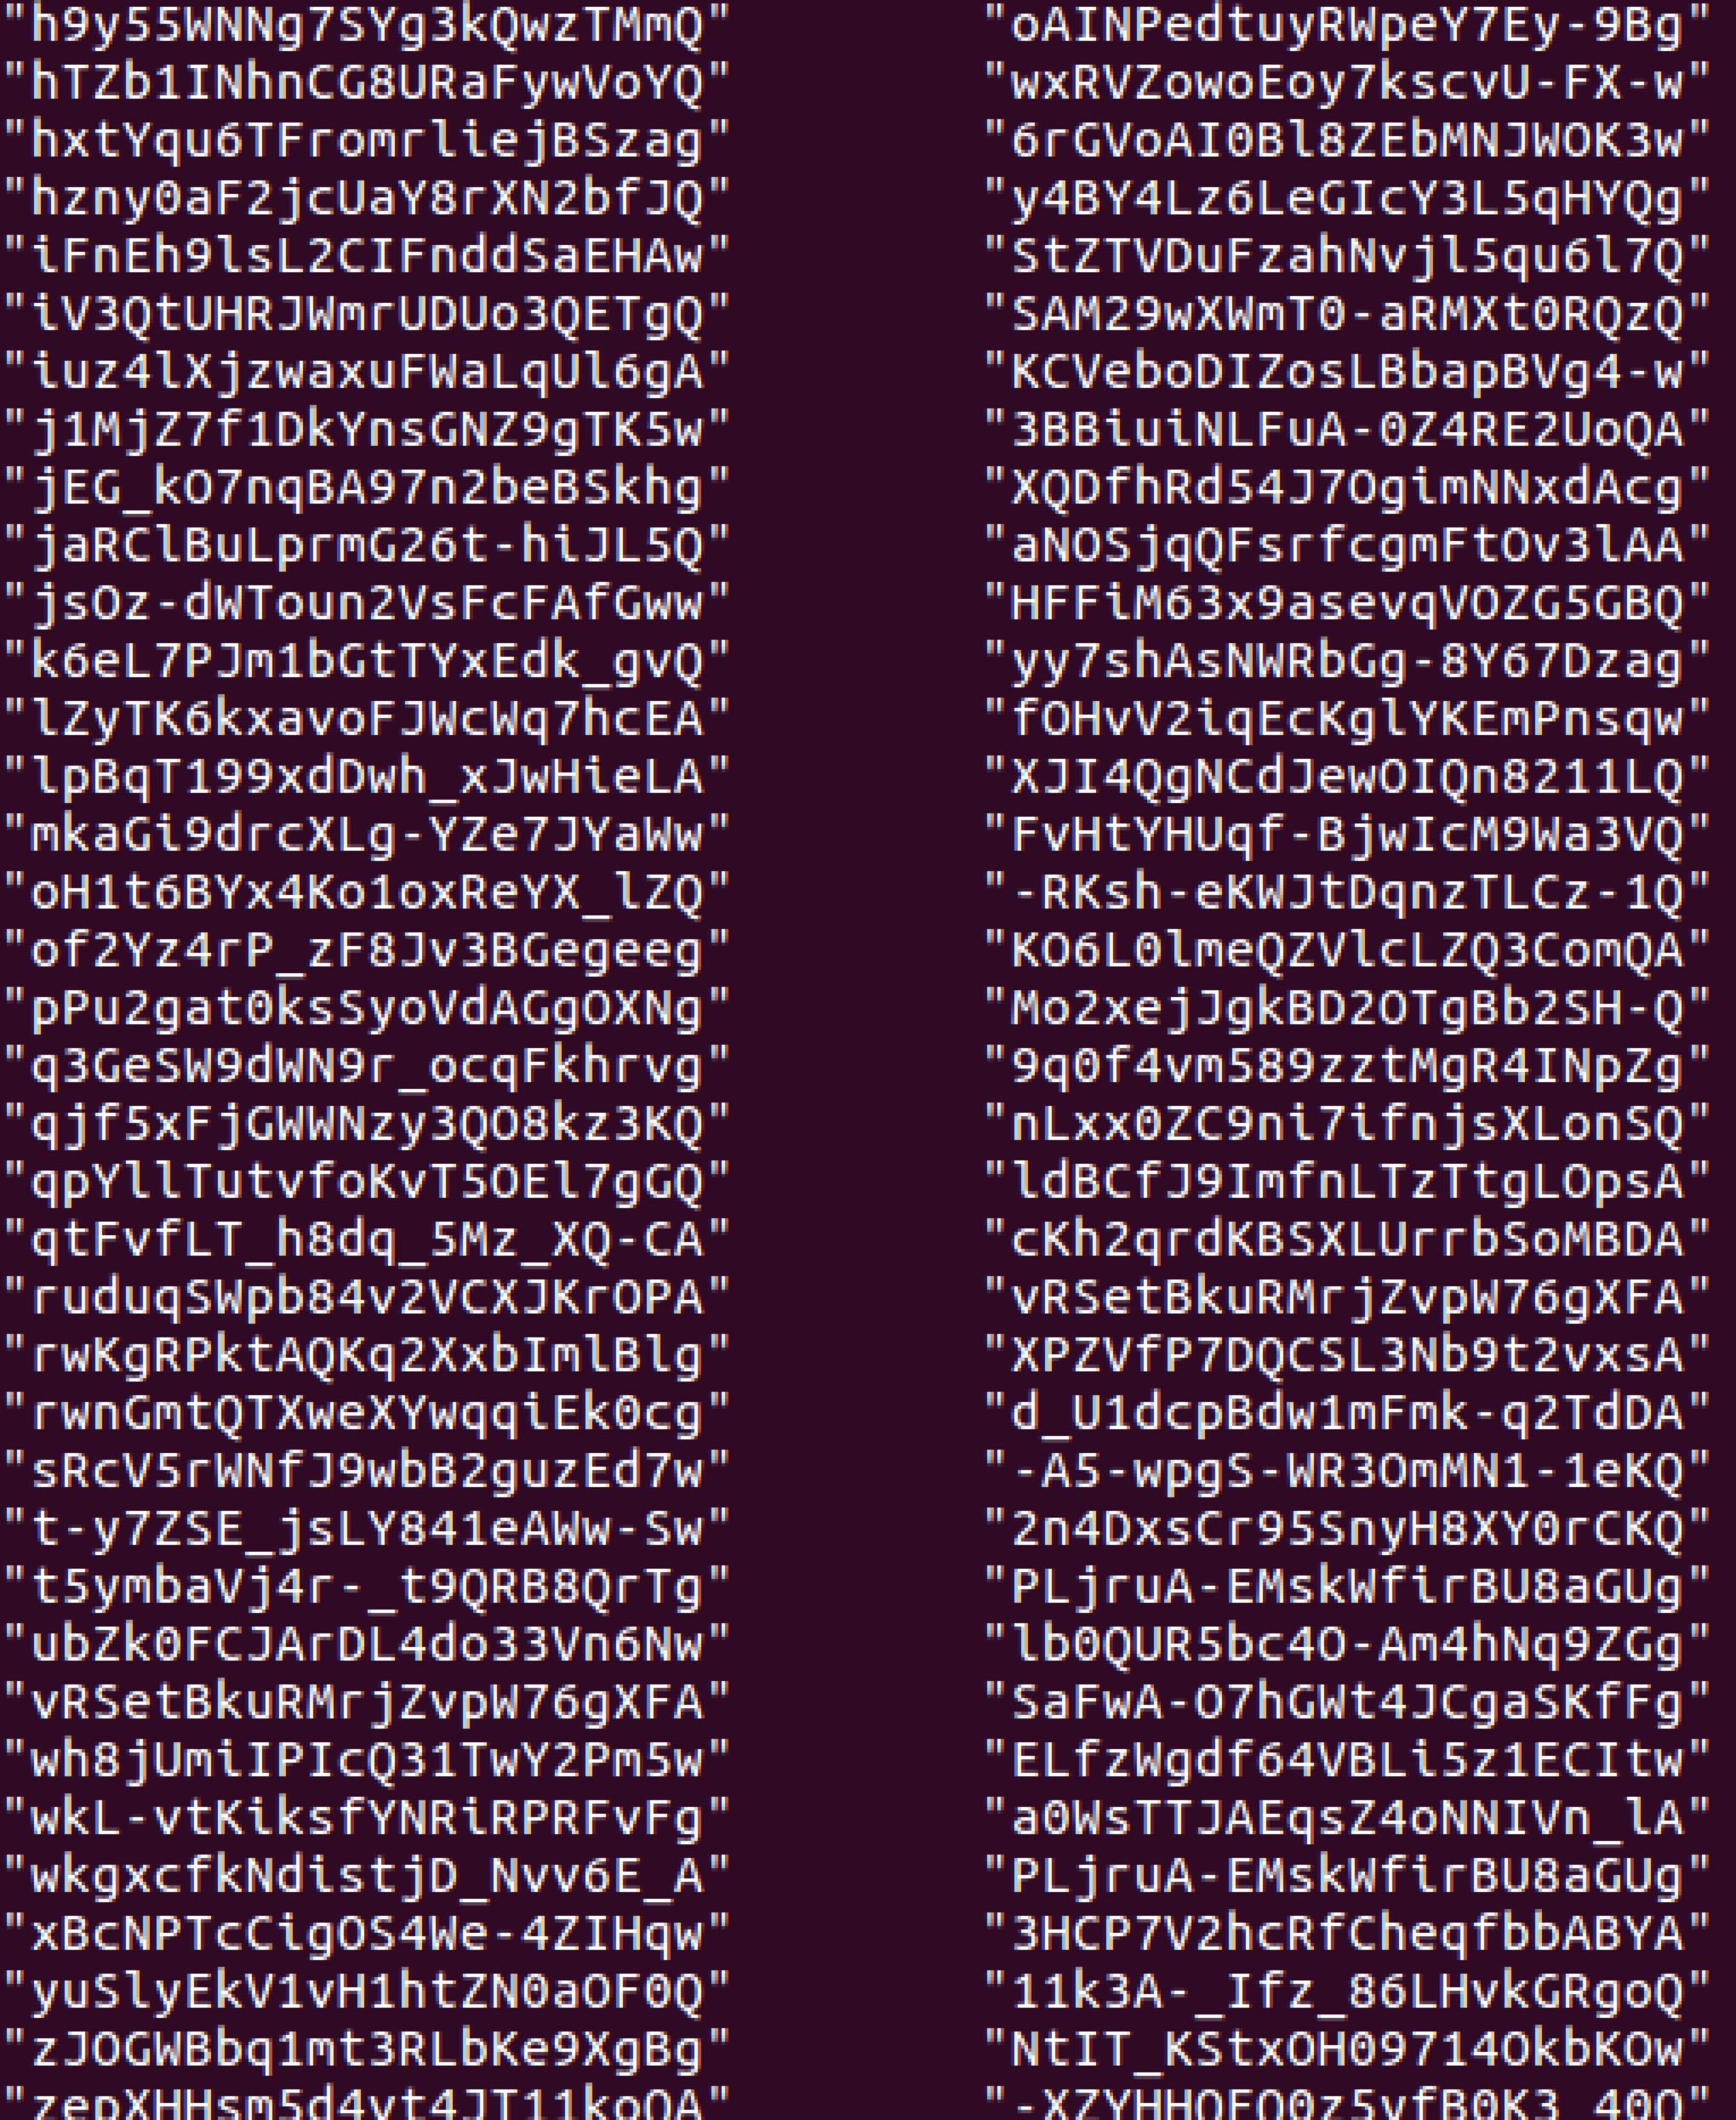
Results-Friend recommendation
- apply the model on the whole dataset
- a user and his/her most similar user (recommend friend)

Slide 11
references
http://aimotion.blogspot.com/2012/08/introduction-to-recommendations-with.html
Bodoia, Max. "Map-Reduce Algorithms for k-means Clustering." accessed online at: https://stanford. edu/~ rezab/classes/cme323 S 16.

